Slide 1
Mining Data Streams
Jiawei Han
Computer Science
University of Illinois at Urbana-Champaign
April 4, 2016

Slide 2


Slide 3
Mining Data Streams
What is stream data? stream data management systems? and stream data mining?
Stream data cube and multidimensional OLAP analysis
Stream frequent pattern analysis
Stream classification
Stream cluster analysis
Summary

Slide 4
Data Streams and Their Characteristics
Data Streams
Features: Continuous, ordered, changing, fast, huge volume
Contrast with traditional DBMS (finite, persistent data sets)
Characteristics
Huge volumes of continuous data, possibly infinite
Fast changing and requires fast, real-time response
Data stream captures nicely our data processing needs of today
Random access is expensive: single scan algorithm (can only have one look)
Store only the summary of the data seen thus far
Most stream data are at low-level and multi-dimensional in nature, needs multi-level and multi-dimensional processing

Slide 5
Streaming Data Applications
Telecommunication calling records
Business: credit card transaction flows
Network monitoring and traffic engineering
Financial market: stock exchange
Engineering & industrial processes: power supply & manufacturing
Sensor, monitoring & surveillance: video streams, RFIDs
Security monitoring
Web logs and Web page click streams
Massive data sets (even saved but random access is too expensive)

Slide 6
DBMS vs. DSMS (Data Stream Management Systems)
Persistent relations
One-time queries
Random access
“Unbounded” disk store
Only current state matters
No real-time services
Relatively low update rate
Data at any granularity
Assume precise data
Access plan determined by query processor, physical DB design
Transient streams
Continuous queries
Sequential access
Bounded main memory
Historical data is important
Real-time requirements
Possibly multi-GB arrival rate
Data at fine granularity
Data stale/imprecise
Unpredictable/variable data arrival and characteristics
Ack. From Motwani’s PODS’04 tutorial slides

Slide 7
Stream Data Processing: An Architecture
Data Streams
Continuous, ordered, changing, fast, huge volume
Single-scan algorithm
User/Application
Continuous Query
Results
Multiple streams
Stream Processing
System
Q: How can we perform cluster analysis effectively in data streams?
Scratch Space
(Main memory and/or Disk)

Slide 8
Challenges of Stream Query Processing
Multiple, continuous, rapid, time-varying, ordered streams
Main memory computations
Queries are often continuous
Evaluated continuously as stream data arrives
Answer updated over time
Queries are often complex
Beyond element-at-a-time processing
Beyond stream-at-a-time processing
Beyond relational queries (scientific, data mining, OLAP)
Multi-level/multi-dimensional query processing
Most stream data are at low-level or multi-dimensional in nature

Slide 9
Stream Data Mining Tasks
Stream mining vs. stream querying
Stream mining shares many difficulties with stream querying
E.g., single-scan, fast response, dynamic, …
But often requires less “precision”, e.g., no join, grouping, sorting
Patterns are hidden and more general than querying
Stream data mining tasks
Multi-dimensional on-line analysis of streams
Pattern mining in data streams
Classification of stream data
Clustering data streams
Mining outliers and anomalies in stream data

Slide 10
Challenges of Mining Dynamics in Data Streams
Most stream data are at pretty low-level or multi-dimensional in nature: needs ML/MD processing
Analysis requirements
Multi-dimensional trends and unusual patterns
Capturing important changes at multi-dimensions/levels
Fast, real-time detection and response
Comparing with data cube: Similarity and differences
Stream (data) cube or stream OLAP: Is this feasible?
Can we implement it efficiently?

Slide 11
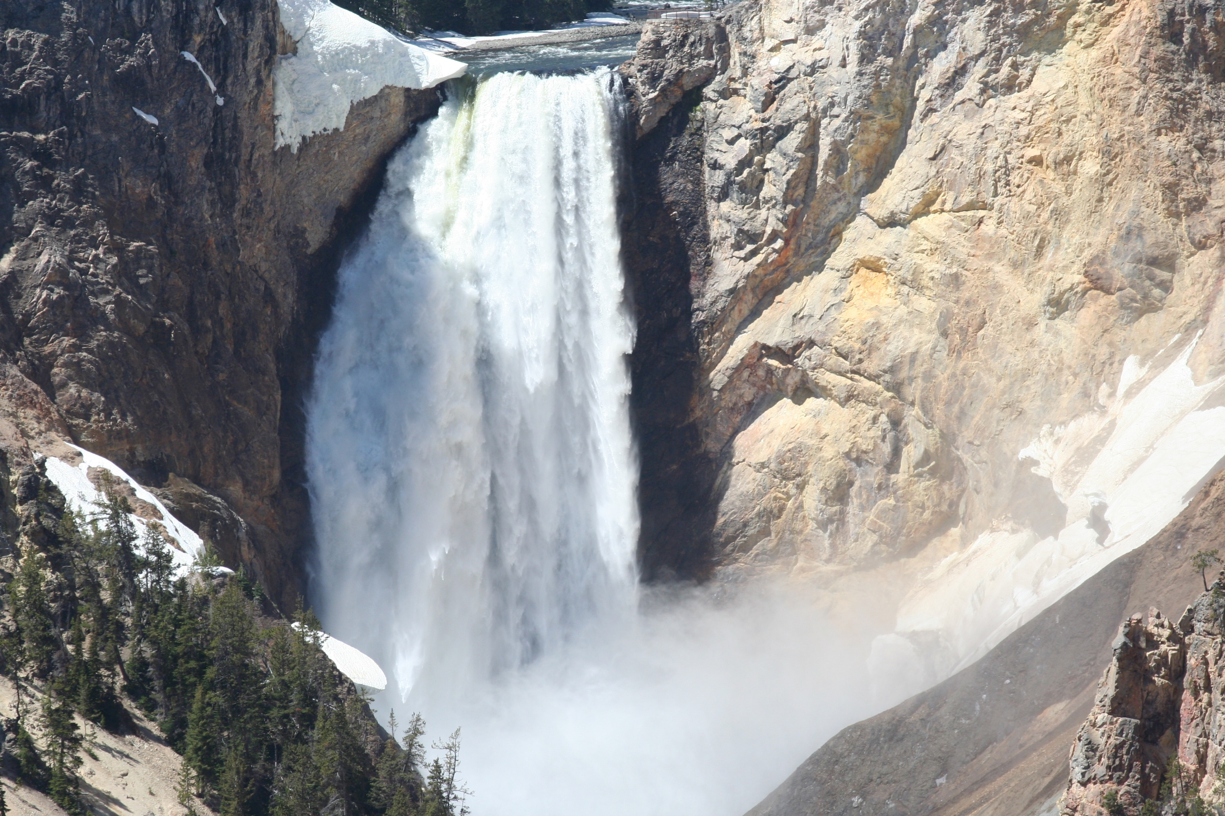

Slide 12
Mining Data Streams
What is stream data? stream data management systems? and stream data mining?
Stream data cube and multidimensional OLAP analysis
Stream frequent pattern analysis
Stream classification
Stream cluster analysis
Summary

Slide 13
Multi-Dimensional Stream Analysis: Examples
Analysis of Web click streams
Raw data at low levels: seconds, web page addresses, user IP addresses, …
Analysts want: changes, trends, unusual patterns, at reasonable levels of details
E.g., Average clicking traffic in North America on sports in the last 15 minutes is 40% higher than that in the last 24 hours.”
Analysis of power consumption streams
Raw data: power consumption flow for every household, every minute
Patterns one may find: average hourly power consumption surges up 30% for manufacturing companies in Chicago in the last 2 hours today than that of the same day a week ago

Slide 14
A Stream Cube Architecture
A tilted time frame
Different time granularities
second, minute, quarter, hour, day, week, …
Critical layers
Minimum interest layer (m-layer)
Observation layer (o-layer)
User: watches at o-layer and occasionally needs to drill-down down to m-layer
Partial materialization of stream cubes
Full materialization: too space and time consuming
No materialization: slow response at query time
Partial materialization: what do we mean “partial”?

Slide 15
Cube: A Lattice of Cuboids
all
0-D(apex) cuboid
time
item
location
supplier
1-D cuboids
time,location
item,location
location,supplier
time,item
2-D cuboids
time,supplier
item,supplier
time,location,supplier
3-D cuboids
time,item,location
time,item,supplier
item,location,supplier
4-D(base) cuboid
time, item, location, supplier

Slide 16
Time Dimension: A Tilted Time Model
Tilted time frames: A trade-off between space and granularity of time
Decide at what moments the snapshots of the statistical information are stored
Design: Natural, logarithmic and pyramidal tilted time frames
Natural tilted time frame:
Ex: Minimal: 15min, then 4 * 15mins → 1 hour, 24 hours → day, …
Logarithmic tilted time frame:
Ex. Minimal: 1 minute, then 1, 2, 4, 8, 16, 32, …

Slide 17
Two Critical Generalized Layers in the Stream Cube
Raw data stream sits at the “primitive” stream data layer
Stream data is generalized to m-layer (minimal interest layer) and “stored” to facilitate flexible drilling
Stream data should be constantly summarized and presented at the o-layer (observation layer) for constant observation
(*, theme, quarter)
o-layer (observation)
(user-group, URL-group, minute)
m-layer (minimal interest)
(individual-user, URL, second)
(primitive) stream data layer

Slide 18
OLAP Operation and Cube Materialization
OLAP( Online Analytical Processing) operations:
Roll up (drill-up): summarize data
by climbing up hierarchy or by dimension reduction
Drill down (roll down): reverse of roll-up
from higher level summary to lower level summary or detailed data, or introducing new dimensions
Slice and dice: project and select
Pivot (rotate): reorient the cube, visualization, 3D to series of 2D planes
Cube partial materialization
Store some pre-computed cuboids for fast online processing

Slide 19
On-Line Partial Materialization
Materialization takes precious space and time
Only incremental materialization (with tilted time frame)
Only materialize “cuboids” of the critical layers?
Online computation may take too much time
Preferred solution:
Popular-path approach: Materializing those along the popular drilling paths
H-tree structure: Such cuboids can be computed and stored efficiently using the H-tree structure
Materialization on Popular Path

Slide 20
OLAP Processing Using Stream Cubes
Online aggregation vs. query-based computation
Online computing while streaming: aggregating stream cubes
Query-based computation: Using computed cuboids
An H-tree cubing Structure (Ref.: Han, et al., SIGMOD’01)
Space preserving
Intermediate aggregates can be computed incrementally and saved in tree nodes
Facilitate computing other cells and multi-dimensional analysis
H-tree with computed cells can be viewed as stream cube
root
Observation layer
Chicago
Urbana
Springfield
.com
.edu
.com
.gov
Minimal int. layer
Elec
Chem
Elec
Bio
6:00AM-7:00AM 156
7:00AM-8:00AM 201
8:00AM-9:00AM 235
……

Slide 21
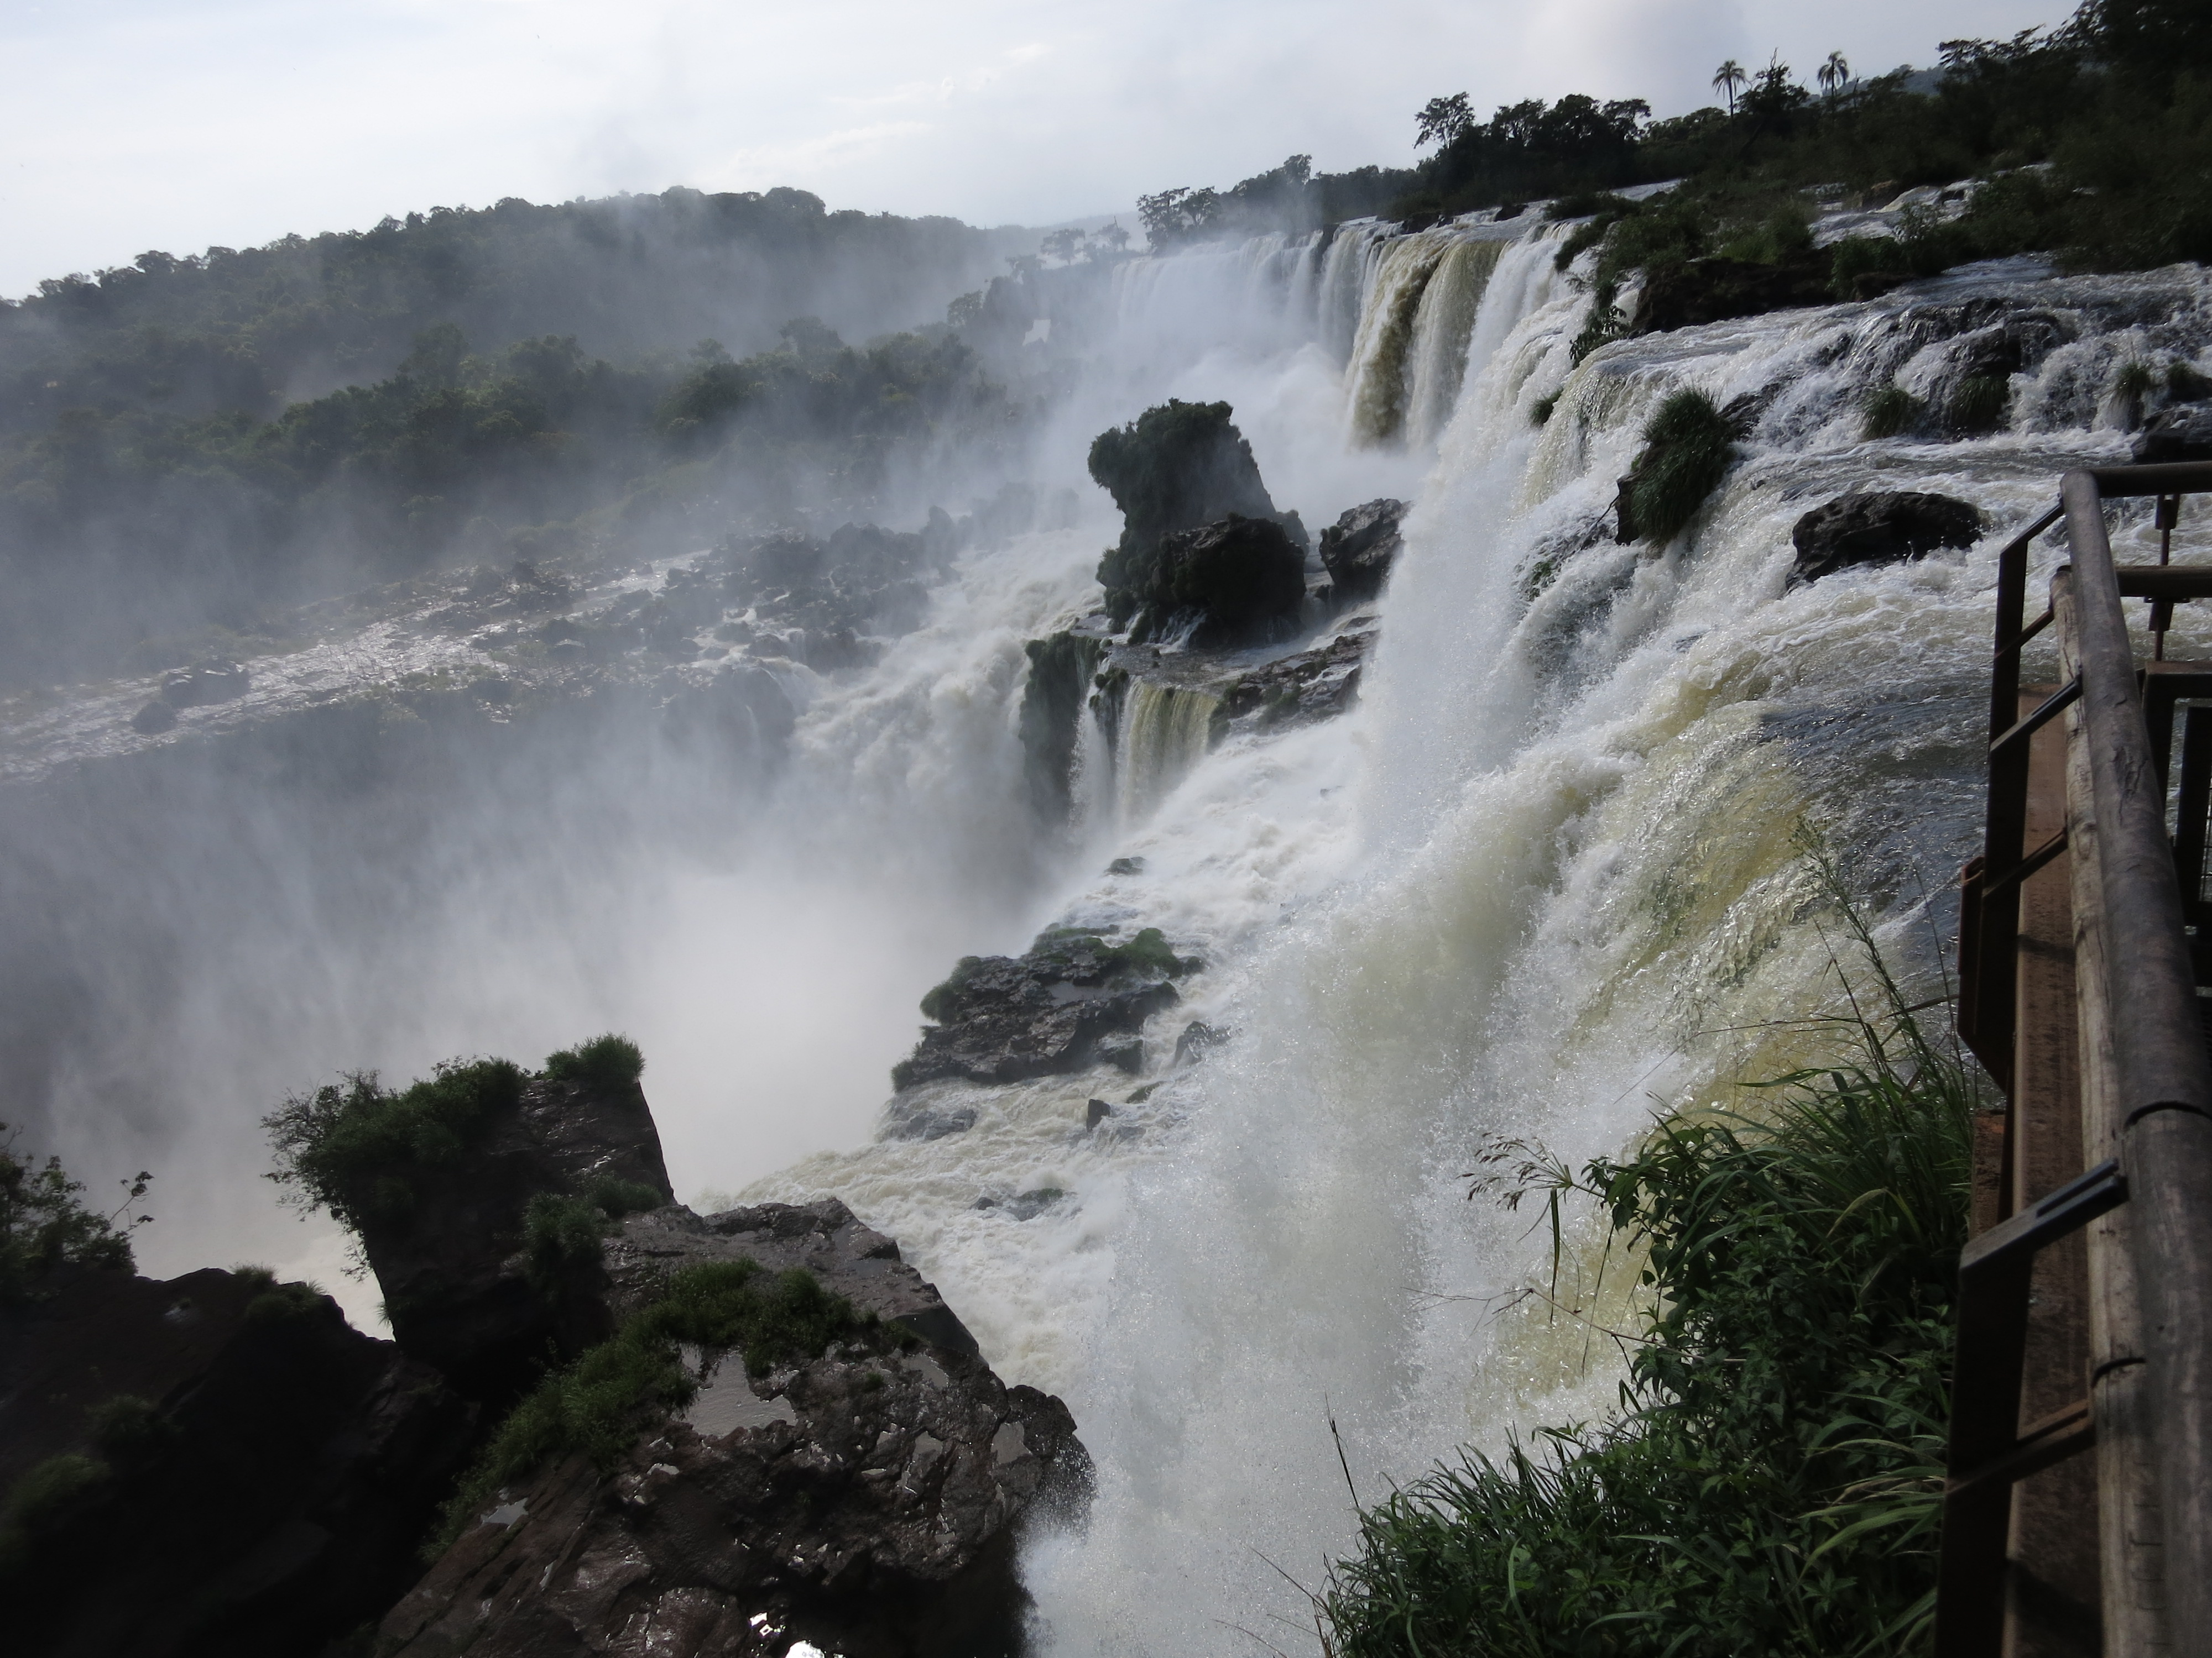

Slide 22
Mining Data Streams
What is stream data? stream data management systems? and stream data mining?
Stream data cube and multidimensional OLAP analysis
Stream frequent pattern analysis
Stream classification
Stream cluster analysis
Summary

Slide 23
Mining Approximate Frequent Patterns
Mining precise frequent patterns in stream data: Unrealistic
Cannot even store them in a compressed form (e.g., FPtree)
Approximate answers are often sufficient for pattern analysis
Ex.: A router
is interested in all flows whose frequency is at least 1% (σ) of the entire traffic stream seen so far
and feels that 1/10 of σ (ε = 0.1%) error is comfortable
How to mine frequent patterns with good approximation?
Lossy Counting Algorithm (Manku & Motwani, VLDB’02)
Major ideas: Not to keep the items with very low support count
Advantage: Guaranteed error bound
Disadvantage: Keeping a large set of traces

Slide 24
Lossy Counting for Frequent Single Items
Bucket 1
Bucket 2
Bucket 3
Divide stream into ‘buckets’ (bucket size is 1/ ε = 1000)
First Bucket of the Stream
Empty (summary)
+
At bucket boundary, decrease all counters by 1
Next Bucket of the Stream
+

Slide 25
Approximation Guarantee
Given: (1) support threshold: σ, (2) error threshold: ε, and (3) stream length N
Output: items with frequency counts exceeding (σ – ε) N
How much do we undercount?
If stream length seen so far = N and bucket-size = 1/ε
then frequency count error ≤ # of buckets
= N/bucket-size = N/(1/ε) = εN
Approximation guarantee
No false negatives
False positives have true frequency count at least (σ–ε)N
Frequency count underestimated by at most εN

Slide 26
Lossy Counting for Frequent Itemsets
Divide Stream into ‘Buckets’ as for frequent items, but fill as many buckets as possible in main memory one time
Bucket 1
Bucket 2
Bucket 3
If we put 3 buckets of data into main memory, then decrease each frequency count by 3
Update summary data structure
Itemset ( ) is deleted. That’s why we choose a large number of buckets–delete more
Pruning Itemsets – Apriori Rule
If we find itemset ( ) is not frequent, we needn’t consider its superset
2
4
3
2
4
3
1
+
2
10
9
1
2
1
2
1
0
summary data
3 bucket data
in memory
summary data

Slide 27
Other Issues and Recommended Readings
Other issues on pattern discovery in data streams
Space-saving computation of frequent and top-k elements (Metwally, Agrawal, and El Abbadi, ICDT'05)
Mining approximate frequent k-itemsets in data streams
Mining sequential patterns in data streams
Recommended Readings
G. Manku and R. Motwani, “Approximate Frequency Counts over Data Streams”, VLDB’02
A. Metwally, D. Agrawal, and A. El Abbadi, “Efficient Computation of Frequent and Top-k Elements in Data Streams”, ICDT'05

Slide 28


Slide 29
Mining Data Streams
What is stream data? stream data management systems? and stream data mining?
Stream data cube and multidimensional OLAP analysis
Stream frequent pattern analysis
Stream classification
Stream cluster analysis
Summary

Slide 30
Classification for Dynamic Data Streams
Decision tree induction for stream data classification
VFDT (Very Fast Decision Tree)/CVFDT (Domingos, Hulten, Spencer, KDD00/KDD01)
Is decision-tree good for modeling fast changing data, e.g., stock market analysis?
Other stream classification methods
Instead of decision-trees, consider other models
Naïve Bayesian
Ensemble (Wang, Fan, Yu, Han. KDD’03)
K-nearest neighbors (Aggarwal, Han, Wang, Yu. KDD’04)
Classifying skewed stream data (Gao, Fan, and Han, SDM'07)
Evolution modeling: Tilted time framework, incremental updating, dynamic maintenance, and model construction
Comparing of models to find changes

Slide 31
Very Fast Decision Tree for Data Streams
Very Fast Decision Trees(VFDT) (Domingos, et al., KDD’00)
Hoeffding's inequality: A result in probability theory that gives an upper bound on the probability for the sum of random variables to deviate from its expected value
Based on Hoeffding Bound principle, classifying different samples leads to the same model with high probability—can use a small set of samples
Hoeffding Bound (Additive Chernoff Bound)
Given: r: random variable, R: range of r, N: # independent observations
True mean of r is at least r_{avg} – ε,
with probability 1 – δ
(where δ is user-specified)
Data Stream
Packets > 10
yes
no
Protocol = http
Packets > 10
Data Stream
yes
no
Bytes > 60K
Protocol = http
yes
Protocol = ftp
Ack. From Gehrke’s SIGMOD tutorial slides

Slide 32
Hoeffding Tree: How to Handle Concept Drifts?
Hoeffding Tree: strengths and weakness
Scales better than traditional methods
Sublinear with sampling
Very small memory utilization
Incremental
Make class predictions in parallel
New examples are added as they come
Weakness
Could spend a lot of time with ties
Memory used with tree expansion
Number of candidate attributes
Concept Drift
Time-changing data streams
Incorporate new and eliminate old
CVFDT (Concept-adapting VFDT)
Increments count with new example
Decrement old example
Sliding window
Nodes assigned monotonically increasing IDs
Grows alternate subtrees
When alternate more accurate: Replace the old one
O(w) better runtime than VFDT-window

Slide 33
Ensemble of Classifiers
Ensemble is a better way to handle concept drift than single trees
H. Wang, W. Fan, P. S. Yu, and J. Han, “Mining Concept-Drifting Data Streams using Ensemble Classifiers”, KDD'03
Method (derived from the ensemble idea in classification)
Train K classifiers from K chunks
For each subsequent chunk
train a new classifier
test other classifiers against the chunk
assign weight to each classifier
select top K classifiers

Slide 34
Issues in Stream Classification
Descriptive model vs. generative model
Generative models assume data follows some distribution while descriptive models make no assumptions
Distribution of stream data is unknown and may evolve, so descriptive model is better
Label prediction vs. probability estimation
Classify test examples into one class or estimate P(y|x) for each y
Probability estimation is better:
Stream applications may be stochastic (an example could be assigned to several classes with different probabilities)
Probability estimates provide confidence information and could be used in post processing

Slide 35
Classifying Data Streams with Skewed Distribution
Problems of typical classification methods on skewed data:
Tend to ignore positive examples due to the small number
The cost of misclassifying positive examples is usually huge, e.g., misclassifying credit card fraud as normal
Classify data stream with skewed distribution (i.e., rare events)
Employ both biased sampling and ensemble techniques
Reduce classification errors on the minority class

Slide 36
Concept Drifts
Changes in P(x, y) x-feature vector y-class label P(x,y) = P(y|x)P(x)
Four possibilities:
No change: P(y|x), P(x) remain unchanged
Feature change: only P(x) changes
Conditional change: only P(y|x) changes
Dual change: both P(y|x) and P(x) changes
Expected error:
No matter how concept changes, the expected error could increase, decrease, or remain unchanged
Training on the most recent data could help reduce expected error

Slide 37
Stream Ensemble Approach
Biased Sampling
………
?
………
S₁
S₂
Ensemble
S_{m}
S₁
S₂
S_{m}
S_{m+1}
………
?
Classification Model
S_{m} as training data? Two few positive examples!
C₁
C₂
C_{k}
Ideas of Stream Ensemble
Biased sampling: Save only the positive examples in the streams
Ensemble: Partition negative examples of S_{m} into k portions to build k classifiers

Slide 38
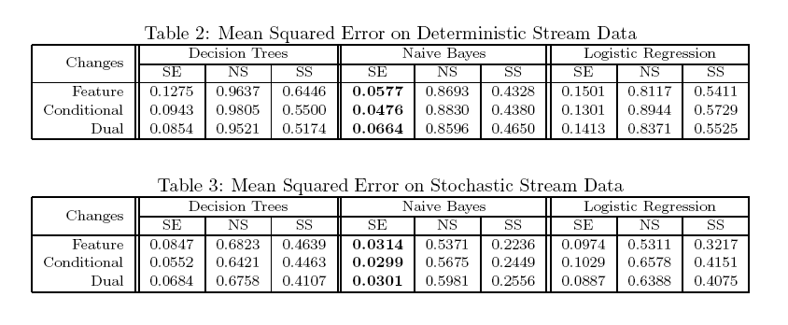
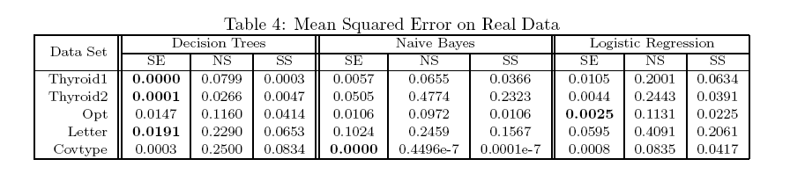
Experiments: Mean Squared Error on Synthetic & Real Data
Test on concept-drift streams (synthetic data)
Test on real data
Stream Ensemble always has lower error rate

Slide 39
Experiments: Model Accuracy and Training Efficiency
Model accuracy
Training time

Slide 40


Slide 41
Mining Data Streams
What is stream data? stream data management systems? and stream data mining?
Stream data cube and multidimensional OLAP analysis
Stream frequent pattern analysis
Stream classification
Stream cluster analysis
Summary

Slide 42
Stream Clustering: A K-Median Approach
O'Callaghan et al. Streaming-Data Algorithms for High-Quality Clustering (ICDE'02)
Base on the k-median method
Data stream points are from metric space
Find k clusters in the stream such that the sum of distances from data points to their closest centers is minimized
A constant factor approximation algorithm
In small space, a simple two-step algorithm
For each set of M records, S_{i}, find O(k) centers in S₁, …, S_{l}
Local clustering: Assign each point in S_{i} to its closest center
Let S’ be centers for S₁, …, S_{l} with each center weighted by the number of points assigned to it
Cluster S’ to find k centers

Slide 43
Hierarchical Clustering Tree
Hierarchical Clustering Tree Method:
Maintain at most m level-i medians
On seeing m of them, generate O(k) level-(i+1) medians of weight equal to the sum of the weights of the intermediate medians assigned to them
level-(i+1) medians
level-i medians
data points
Concerns:
Quality will suffer for evolving data streams (maintaining only m level-i medians)
Limited functionality in discovering and exploring clusters over different portions of the stream over time

Slide 44
CluStream: A Framework for Clustering Evolving Data Streams
C. Aggarwal, J. Han, J. Wang, P. S. Yu, A Framework for Clustering Data Streams, VLDB'03
Design goal of CluStream
High quality for clustering evolving data streams with rich functionality
Stream mining: One-pass over the stream data, limited space usage, high efficiency
The CluStream Methodology
Tilted time frame work: otherwise, will lose dynamic changes
Micro-clustering: better quality than k-means/k-median
Incremental, online processing, and maintenance
Two stages: micro-clustering and macro-clustering
With limited overhead to achieve high efficiency, scalability, quality of results, and power of evolution/change detection

Slide 45
Pyramidal Tilted Time Frame Adopted by CluStream
Pyramidal tilted time frame:
Example: Suppose there are six frames (d = 5) and each takes a maximal of three snapshots
Given a snapshot number N
If N mod 2^{d} = 0, insert into the frame number d
If there are more than three snapshots, eliminate the oldest one
Frame no. | Snapshots (by clock time)
0 | 69 67 65
1 | 70 66 62
2 | 68 60 52
3 | 56 40 24
4 | 48 16
5 | 64 32
Snapshots of a set of micro-clusters are stored following the pyramidal pattern
They are stored at differing levels of granularity depending on the recency
Snapshots are classified into different orders varying from 1 to log(T)
The i-th order snapshots occur at intervals of α^{i} where α ≥ 1
Only the last (α + 1) snapshots are stored

Slide 46
The CluStream Framework: A Micro-Clustering Approach Using the BIRCH CF-Tree Structure
Micro-clusters stored in CF-Tree
Statistical information about data locality
Temporal extension of the cluster-feature vector
Multi-dimensional points with time stamps
Each point contains d dimensions, i.e.,
A micro-cluster for n points is defined as a (2d + 3) tuple
Root
B = 7
L = 6
CF₁
CF₂
CF₃
CF₆
child₁
child₂
child₃
child₆
Non-leaf node
CF₁
CF₂
CF₃
CF₅
child₁
child₂
child₃
child₅
Leaf node
Leaf node
prev
CF₁
CF₂
CF₆
next
prev
CF₁
CF₂
CF₄
next
A CF tree: A height-balanced tree that stores the clustering features (CFs)
The non-leaf nodes store sums of the CFs of their children

Slide 47
CluStream: Clustering Evolving On-Line Data Streams
Divide the clustering process into online and offline components
Online component (micro-cluster maintenance)
Periodically store summary statistics about the stream data
Initially, create q micro-clusters
q is usually significantly larger than the number of natural clusters
Online incremental update of micro-clusters
If new point is within max-boundary, insert into the micro-cluster
Otherwise, create a new cluster
May delete obsolete micro-clusters or merge two closest ones
Offline component (query-based macro-clustering)
Answers various user questions based on the stored summary statistics
Based on a user-specified time-horizon h and the number of macro-clusters k, compute macro-clusters using the k-means algorithm

Slide 48


Slide 49
Mining Data Streams
What is stream data? stream data management systems? and stream data mining?
Stream data cube and multidimensional OLAP analysis
Stream frequent pattern analysis
Stream classification
Stream cluster analysis
Summary

Slide 50
Summary: Stream Data Mining
Stream data mining and stream OLAP analysis:
Real life problem: Effectiveness, efficiency and scalability
Stream OLAP
A multi-dimensional stream analysis framework
Time is a special dimension: Tilted time frame
What to compute and what to save?—Critical layers
Partial materialization and precomputation
Stream data mining
Mining frequent patterns
Stream classification
Stream cluster analysis

Slide 51
References on Stream Data Mining (I)
C. Aggarwal, J. Han, J. Wang, P. S. Yu, “A Framework for Clustering Data Streams”, VLDB'03
C. Aggarwal, J. Han, J. Wang, P. S. Yu, “On-Demand Classification of Evolving Data Streams”, KDD'04
C. Aggarwal, J. Han, J. Wang, and P. S. Yu, “A Framework for Projected Clustering of High Dimensional Data Streams”, VLDB'04
S. Babu and J. Widom, “Continuous Queries over Data Streams”, SIGMOD Record, Sept. 2001
B. Babcock, S. Babu, M. Datar, R. Motwani and J. Widom, “Models and Issues in Data Stream Systems”, PODS'02.
Y. Chen, G. Dong, J. Han, B. W. Wah, and J. Wang, “Multi-Dimensional Regression Analysis of Time-Series Data Streams”, VLDB'02
P. Domingos and G. Hulten, “Mining high-speed data streams”, KDD'00
A. Dobra, M. N. Garofalakis, J. Gehrke, and R. Rastogi, “Processing Complex Aggregate Queries over Data Streams”, SIGMOD’02
J. Gehrke, F. Korn, and D. Srivastava, “On computing correlated aggregates over continuous data streams”, SIGMOD'01
J. Gao, W. Fan, and J. Han, “A General Framework for Mining Concept-Drifting Data Streams with Skewed Distributions”, SDM'07

Slide 52
References on Stream Data Mining (II)
S. Guha, N. Mishra, R. Motwani, and L. O'Callaghan, “Clustering Data Streams”, FOCS'00
G. Hulten, L. Spencer and P. Domingos, “Mining time-changing data streams”, KDD’01
S. Madden, M. Shah, J. Hellerstein, V. Raman, “Continuously Adaptive Continuous Queries over Streams”, SIGMOD’02
G. Manku, R. Motwani, “Approximate Frequency Counts over Data Streams”, VLDB’02
A. Metwally, D. Agrawal, and A. El Abbadi. “Efficient Computation of Frequent and Top-k Elements in Data Streams”. ICDT'05
S. Muthukrishnan, “Data streams: algorithms and applications”, Proc 2003 ACM-SIAM Symp. Discrete Algorithms, 2003
R. Motwani and P. Raghavan, Randomized Algorithms, Cambridge Univ. Press, 1995
S. Viglas and J. Naughton, “Rate-Based Query Optimization for Streaming Information Sources”, SIGMOD’02
Y. Zhu and D. Shasha. “StatStream: Statistical Monitoring of Thousands of Data Streams in Real Time”, VLDB’02
H. Wang, W. Fan, P. S. Yu, and J. Han, “Mining Concept-Drifting Data Streams using Ensemble Classifiers”, KDD'03

